Slide 1
Data Base Management System
1 and 2nd Chapter

Slide 2
File Systems

Slide 3
#include <stdio.h>
#include <stdlib.h>
#include <string.h>
#define BUFFER_SIZE 50
int main()
{
FILE *pFile = NULL;
char *filename = "C:\\myfile.txt"; // File Path
char buffer[80] = “Welcome to sycof"; // Data to be written in file
int buffer_size = BUFFER_SIZE;
size_t str_length = 0;
pFile = fopen(filename, "w"); // File Open Function
if(pFile == NULL)
{
printf("Error opening %s for writing. Program terminated.", filename);
abort();
}
str_length = strlen(buffer);
fwrite(&str_length, sizeof(size_t), 1, pFile);
fwrite(buffer, str_length, 1, pFile);
fclose(pFile);
printf("\nFile write complete\n");
if(buffer != NULL)
free(buffer);
}

Slide 4
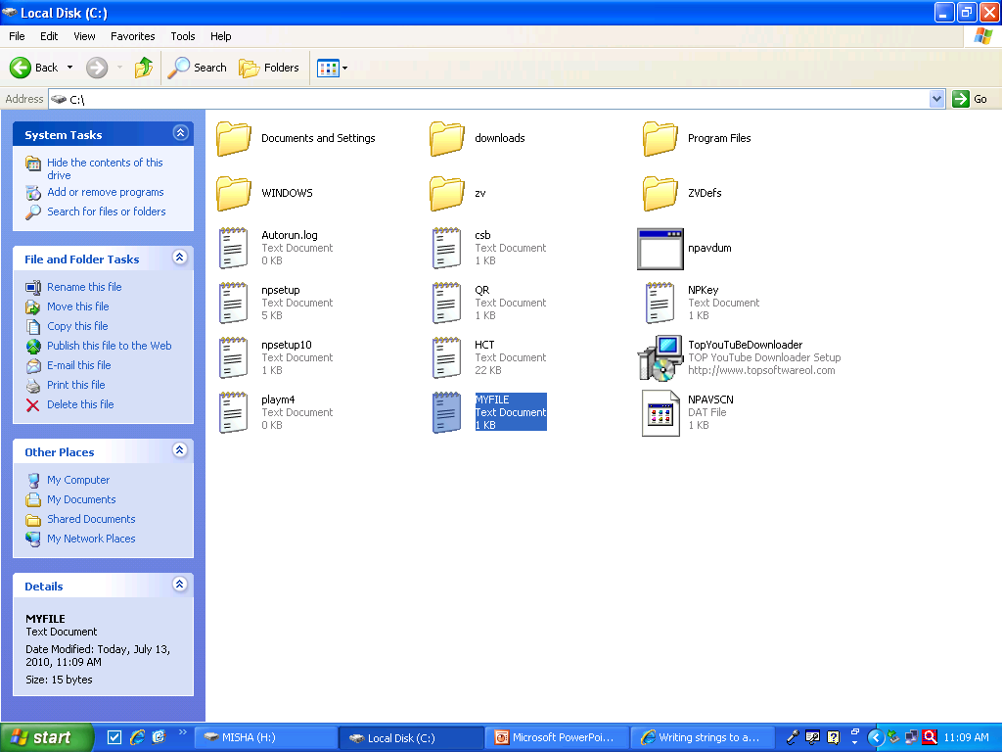

Slide 5


Slide 6
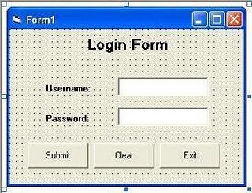
Front End

Slide 7
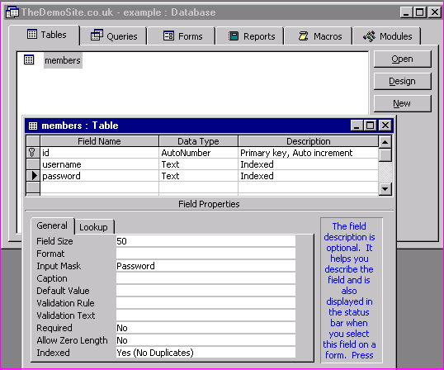
Backend

Slide 8
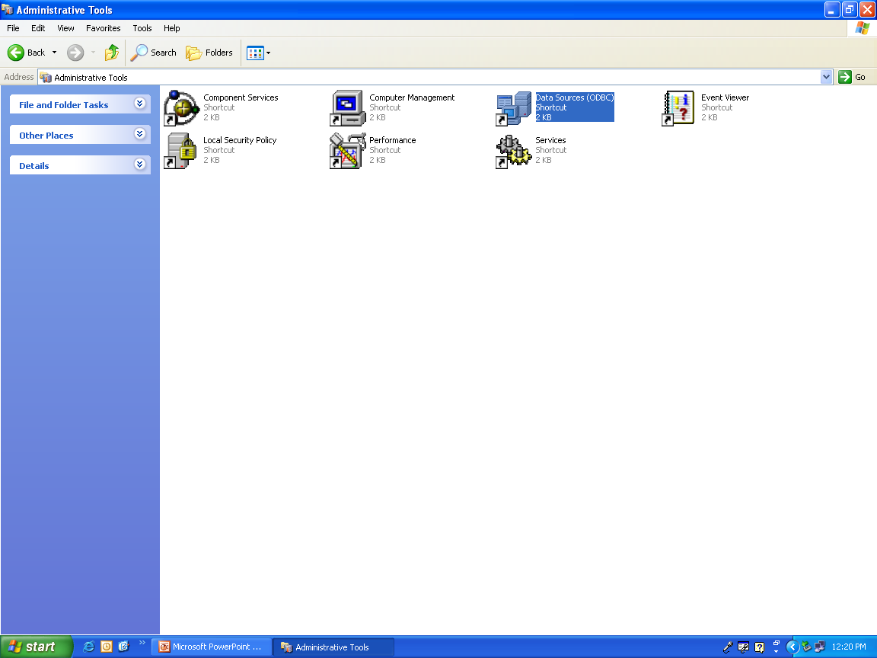
odbc

Slide 9
Data Abstraction

Slide 10
Physical level Data Abstraction
Lowest Level of Abstraction.
Describes how data are actually stored.
Defines lowest complicated data structure.
Hidden from normal users.

Slide 11
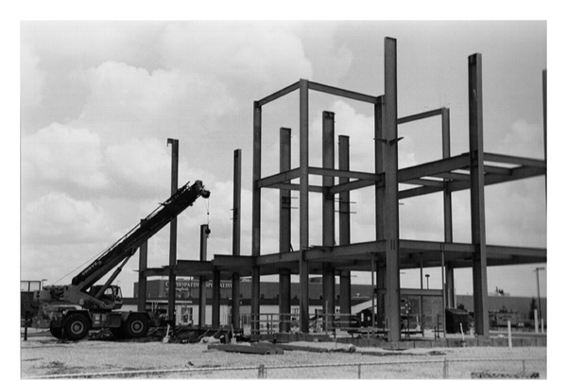
Physical level

Slide 12
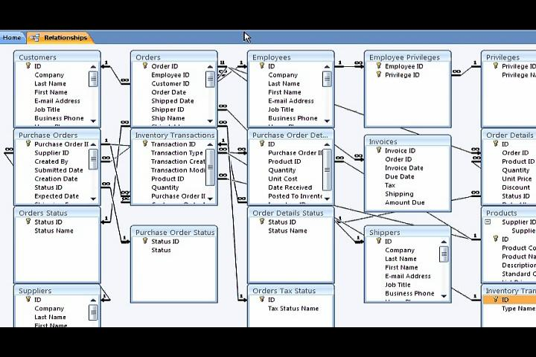
Physical level

Slide 13
Logical level
Next Higher level of data abstraction
Describes what data are stored and relation ships exists among data.
Does not need to be aware of physical level complexity.
Db Admin must decide what data to be stored.

Slide 14

Logical Level

Slide 15
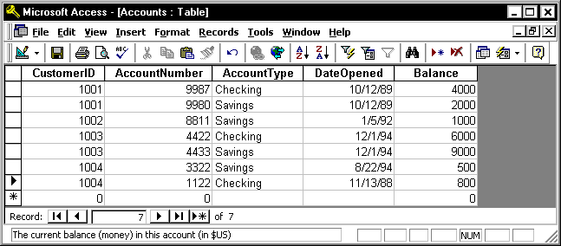
Logical level

Slide 16
View Level
Different view of same database can be created for different users to interact with database in a user-friendly manner.

Slide 17
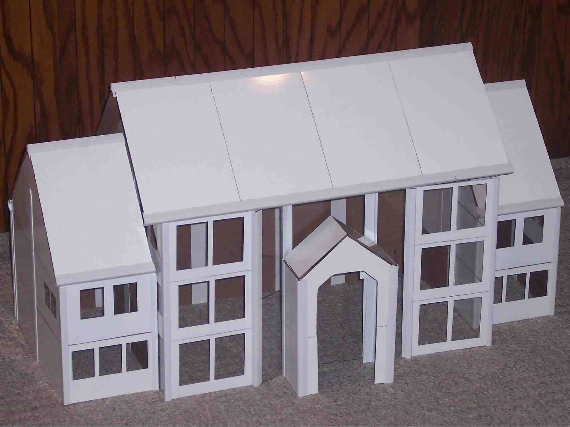
View level

Slide 18

View level

Slide 19
Create Table Command
SQL

Slide 20
Create Table Syntax
Create table <tablename>
(
attribute1_name datatype(size),
.
.
attribute1_name datatype(size)
);

Slide 21
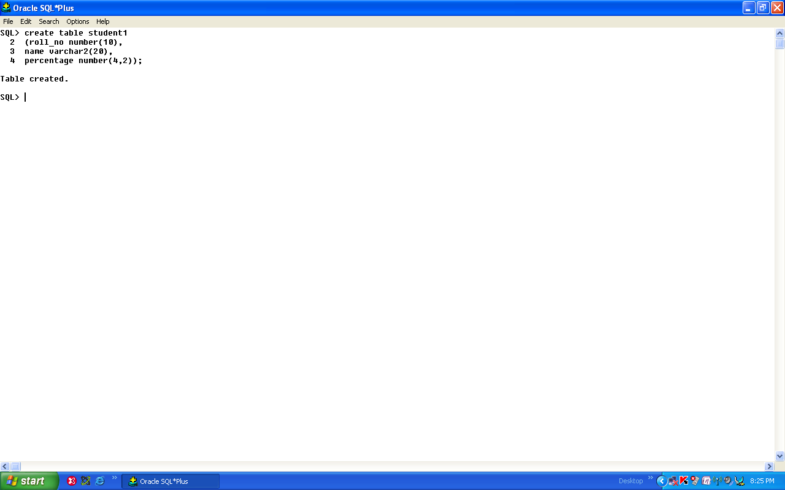
Create table command

Slide 22
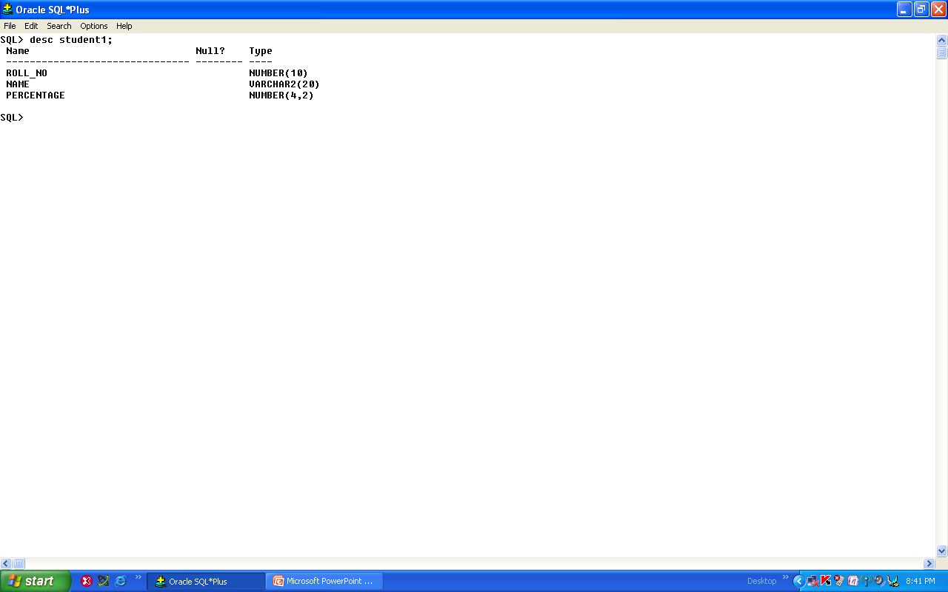

Slide 23
Insert into Command

Slide 24
Insert into Syntax Case a
Insert a row/tuple into a table by specifying attribute and value
Insert into <tablename>
(attributename1,attributename2,……..>)
values
(expression 1,expression 2…. Expression n);

Slide 25
Insert Case b
To insert values for selected attributes
Insert into <tablename>
(attributename1,attributename2)
Values
(expression 1, expression 2);

Slide 26
Insert case c
To insert attributes in the order attributes are declared.
Insert into <tablename>
Values(expression 1, expression 2……..
Expression n);

Slide 27
Insert into Case d
To Insert more than 1 row/tuple.
Insert into <tablename>
Values
(&attribute1,&attribute2,……attribute n);

Slide 28
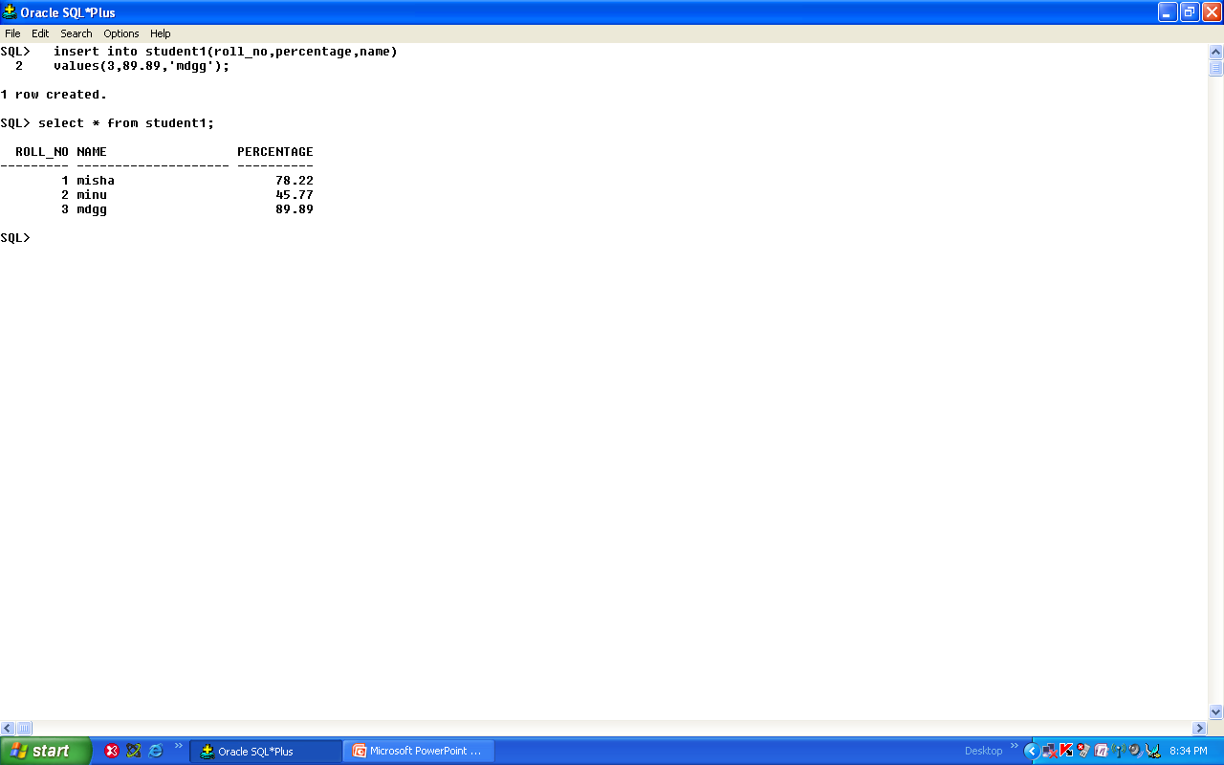

Slide 29
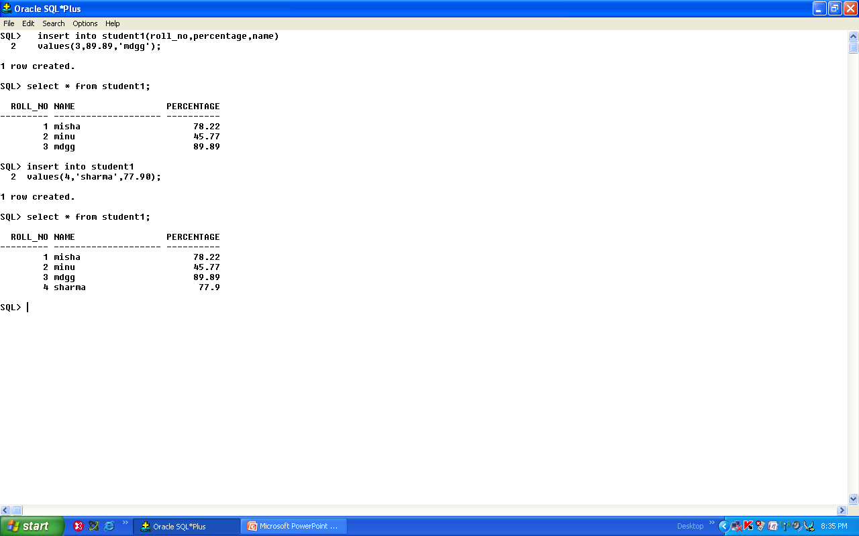

Slide 30
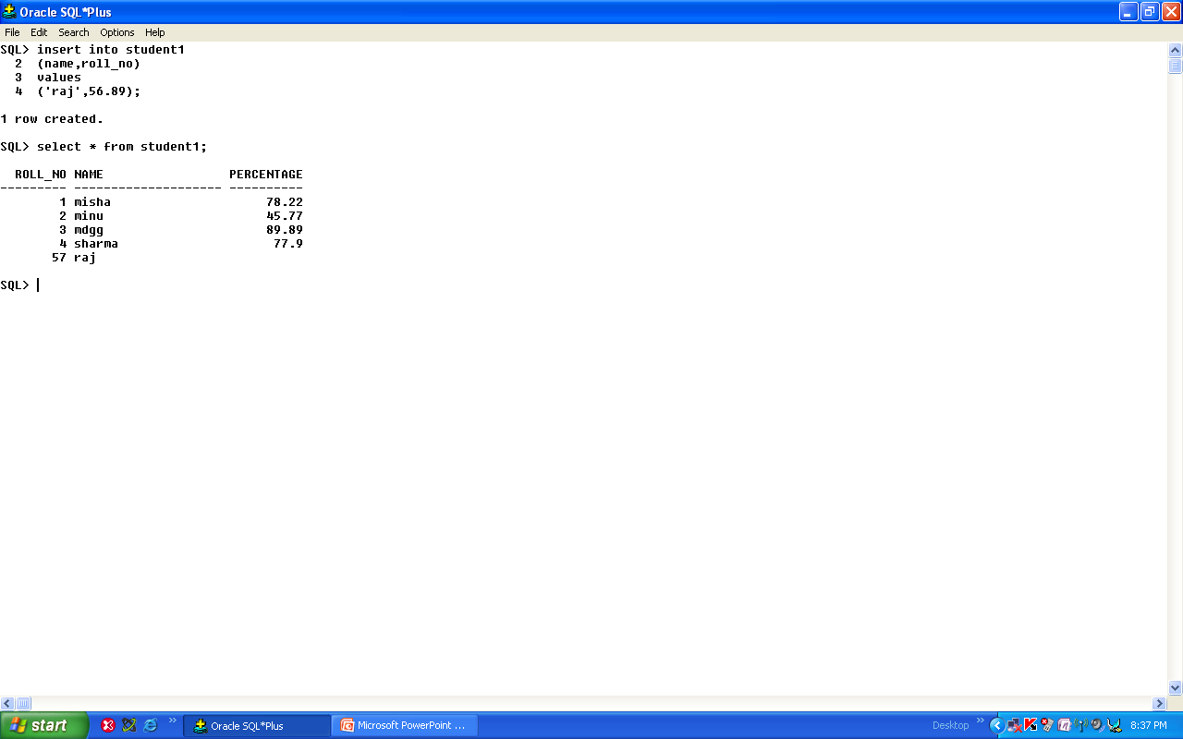

Slide 31
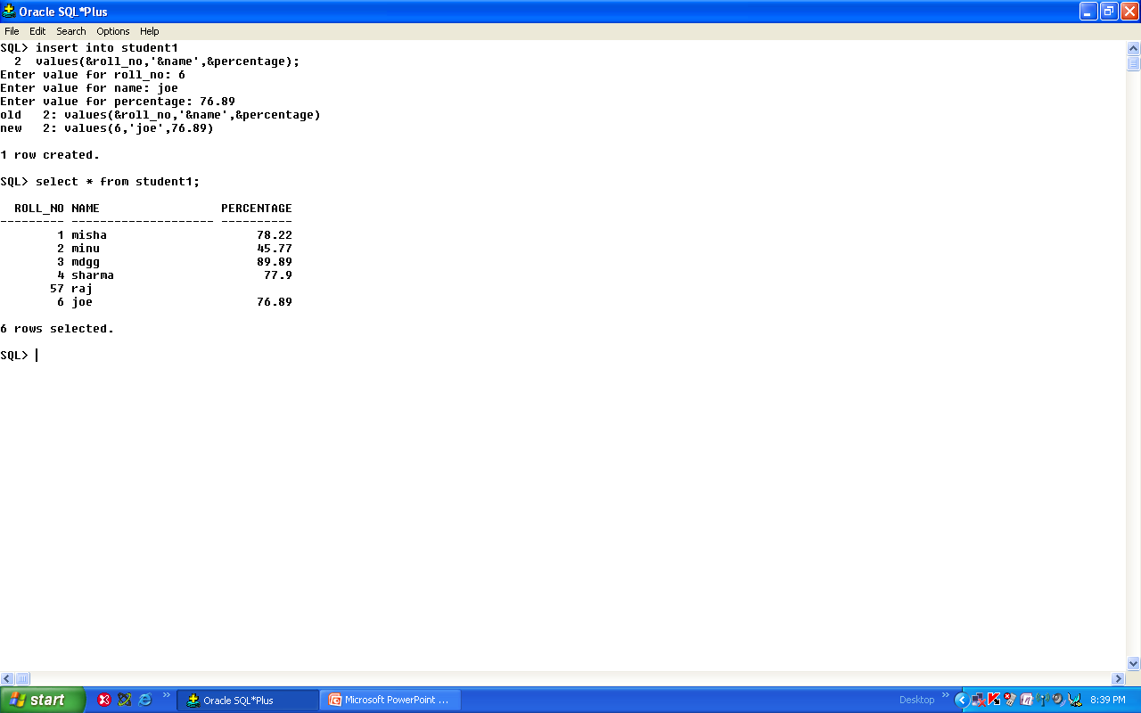

Slide 32
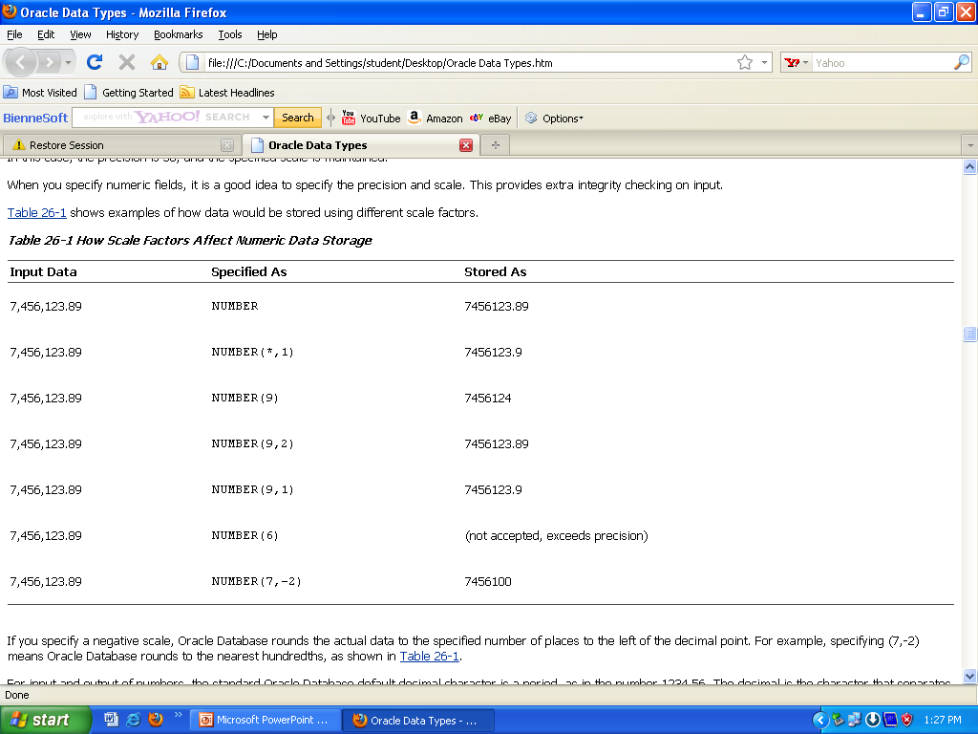

Slide 33
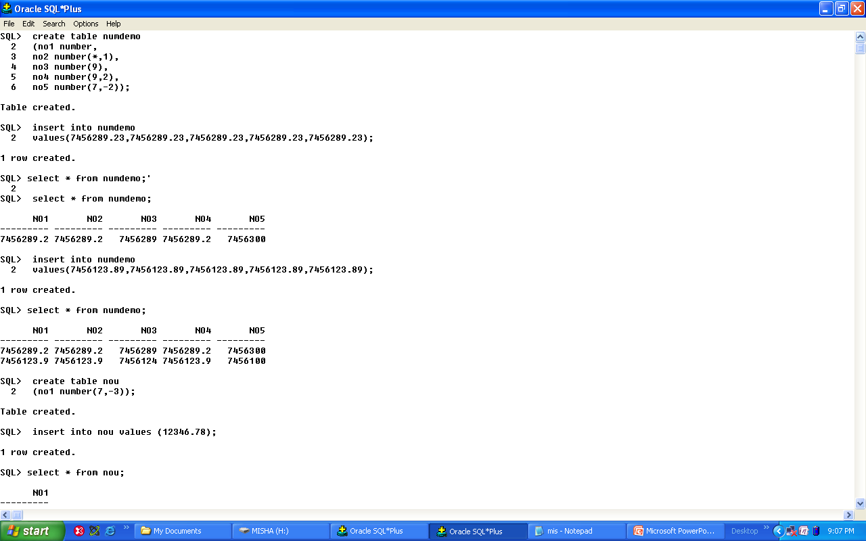

Slide 34
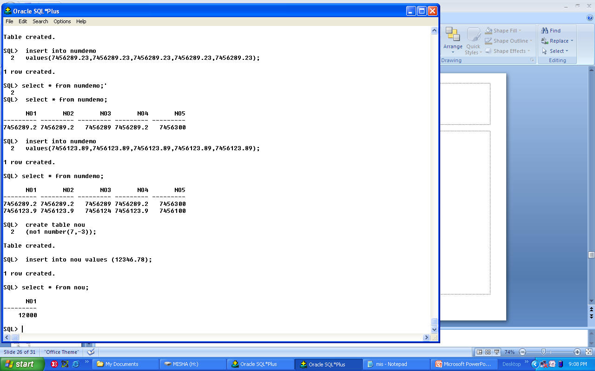

Slide 35
Select Command

Slide 36
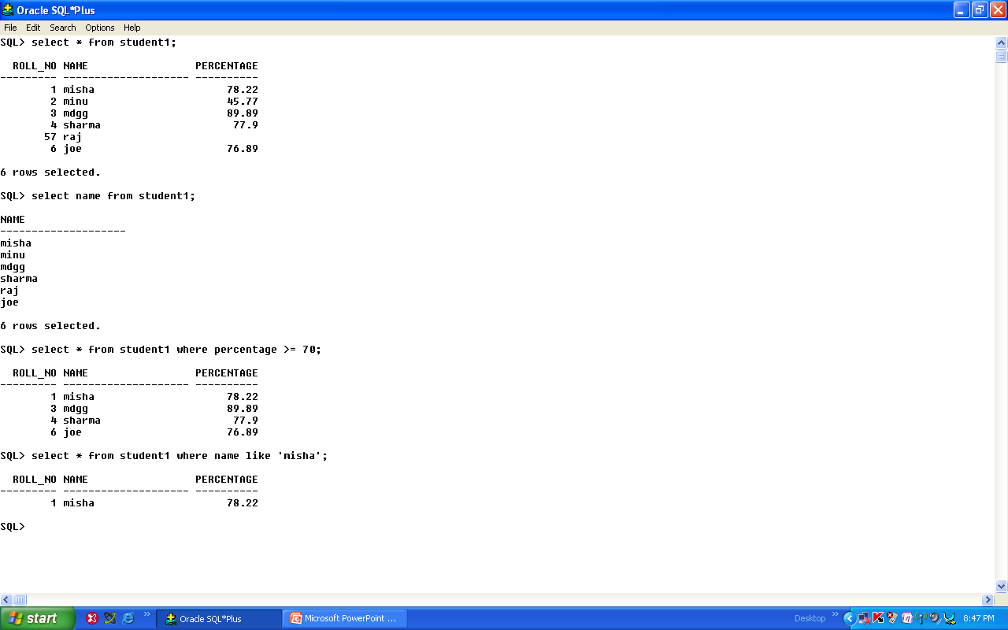

Slide 37
Delete Command

Slide 38
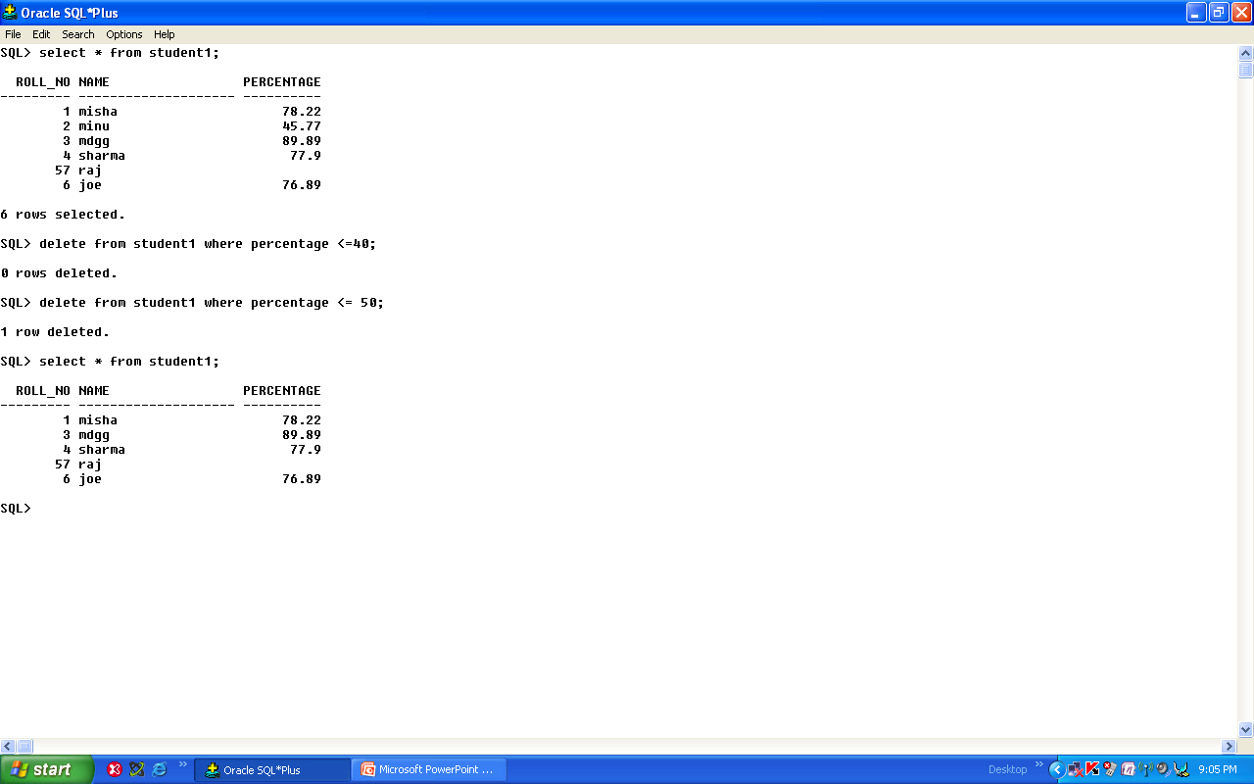

Slide 39
Update Command

Slide 40
